Slide 1
Saying YES to Primary Prevention
Building Prevention Capacity in Virginia’s Sexual & Domestic Violence Agencies

Slide 2
The PROCESS of primary prevention…
Primary prevention =
Improving our understanding of the underlying conditions in our society that perpetuate SV/IPV
Developing and enhancing our ability to change those conditions ultimately, eliminating SV/IPV

Slide 3
DEFINITION of primary prevention
Preventing sexual and intimate partner violence before they occur. Primary prevention efforts exist on a continuum.
This work values and builds on the strengths of diverse cultures to eliminate the root causes of sexual and intimate partner violence, and create healthier social environments.

Slide 4
DEFINITION of Primary Prevention (cont.)
These efforts seek to bring about change in individuals, relationships, communities, and society through strategies that:
1) Promote the factors associated w/ healthy relationships and healthy sexuality, and
2) Counteract the factors associated with the initial perpetration of sexual violence and intimate partner violence.

Slide 6
Activity 1:
- PP Staff (people who work on PP for the majority of their job): What has been your experience when communicating primary prevention concepts with co-workers? General public?
- NON-PP Staff: What was your overall impression of primary prevention work before coming to this conference?
- What are, in your collective opinion (each group), the greatest opportunity and the greatest obstacle to achieving a large reduction in the prevalence of sexual and domestic violence?

Slide 7
Primary Prevention Capacity
Willingness and ability of staff members AND agencies to engage in mission-driven efforts seeking to prevent first-time SV/IPV perpetration in an effective manner.

Slide 8
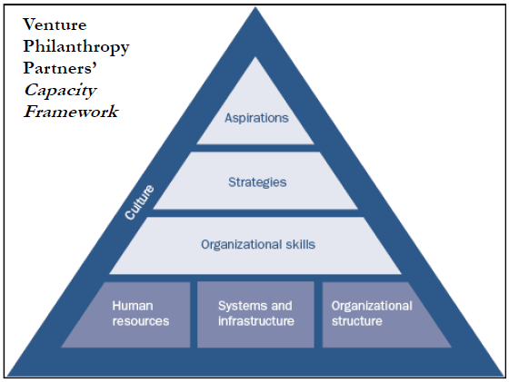

Slide 9
Aspirations & Strategy
The clarity and quality of an agency-wide primary prevention agenda – and how they plan to realize it – will convey much about a SDVA’s prevention capacity.

Slide 11
Organizational Skills
Staff’s abilities to conceive of, map-out, execute, and regularly adjust the implementation of primary prevention initiatives.
Notes:
How management equitably prioritizes this work relative to other projects of the SDVA
Extent to which staff are using prevention-specific promising practices to inform primary prevention initiatives

Slide 13
HR, Systems & Infra, Org Structure
SDVA managers understand the knowledge and skill sets necessary for prevention positions, and are able to accurately represent that understanding in recruitment.
Adapting supervision habits, organizational hierarchy, and staff development strategies to include these requirements of primary prevention work.

Slide 15
Culture
What type of organization, and whether the SDVA and its affiliated individuals view themselves as a primarily a service delivery organization, a social change organization, or neither/other.

Slide 16
Building a “Community of Practice”
Trainings
Prevention website
Webinars & Teleconferences
Annual Retreat
Primary prevention guidelines
WE HAVE TO CONSIDER THE CONTEXT IN WHICH PRIMARY PREVENTION WORK EXISTS AT THE LOCAL LEVEL!

Slide 17
VSDVAA Program Assessment
Primary prevention has/had an IMAGE PROBLEM…the “brand” of primary prevention was:
CONFUSING
IMPOSSIBLE

Slide 18
“Primary prevention is CONFUSING.”
Public health / evaluation concepts and background
Jargon
Seemingly VERY different from service delivery and the predominant identity of local SDVAs

Slide 19
“Primary prevention is IMPOSSIBLE.”
Perpetration prevention = too daunting.
Too abstract. / Too idealistic.

Slide 20
Process for rebranding
What is the current “brand” and is it working for you? (why or why not?)
How do you determine the alternative framing?
How do you develop a new brand for primary prevention work?

Slide 21
“Think about primary prevention as a product in a store….”
What other products would you want it to be associated with? What section of the store would it be in? And why?
What other products would you NOT want to it to be associated with? And why?
We want to communicate that prevention work is…__________________ . / !
Brainstorm a few taglines to “rebrand” primary prevention.

Slide 23
Our process
Audience
General message of our prevention work
Goals
Objectives
Current perception of the work and the counter story
Benefits
Adjectives

Slide 24
Audience
Internal (A)
General public (B)
Folks in the field
SDVAs/CCRs
Community organizations
State partners
Staff/Board
Legislators
People who already have some knowledge of the work

Slide 25
Message - brainstorming
Social justice
The “roots” of our work
Not just the end, but the process too
It’s a way of thinking
Everyone can do this!
Prevention is the “hub” that keeps things together
Before it happens or starts
Enhance/promote
Evidence-based/effective
Link to successful public health campaigns
Realistic and innovative

Slide 26
Goals
Increase # of people who are excited/enthusiastic about prevention (A/B)
Clarify what “it” is. It’s complementary and necessary, and not in lieu of intervention (A)
People are more motivated to engage and ask more questions (A/B)
Help folks understand that this is not new (A)
To reenergize people (A)
Get state funding (A/B)
Is an equal part of IPV/SV work (A)
All staff can describe coalitions prevention work (A)
Increase “support” from individuals (B)

Slide 27
Current perception & counter story
Current perception
Counter story
Hard
Don’t understand it
Not enough resources
Takes away from what programs are supposed to be doing
We’re already doing this!
Amorphous
Hard to measure
Liberal
Takes too long
Not achievable, so why bother!
We are already doing it!
It’s not harder than what you’re currently doing!
Less likely to be shot/stabbed doing prevention…it’s safer!
Hopeful
Can plan for/think about what is possible
Training and tools
Social change work/systemic/ripple effect

Slide 28
Benefits of prevention work
NOT crisis mode
NOT reactionary
Substantial change
Proactive
Tools that improve intervention/responsiveness to community
More working “in” community = more likely to understand community
Visioning

Slide 29
Adjectives
Feel Good
Active, sexy, positive, cool, innovative, energizing
Feel Possible
Realistic, achievable, relevant, energizing, hopeful
Feel Part of It (“Heart”)
Rooted, belonging/connected, utopian, hopeful

Slide 31
Building a community of practice
Prevention Brand “Yes: Changing the future with fresh ideas and effective tools”
Disseminate the brand across membership in various publications (Moving Upstream, Annual Report, etc.)
Prevention Website
A recipe for prevention (card, talking points, and new recipe per month)
Prevention e-group
Technical Assistance & Training

Slide 32
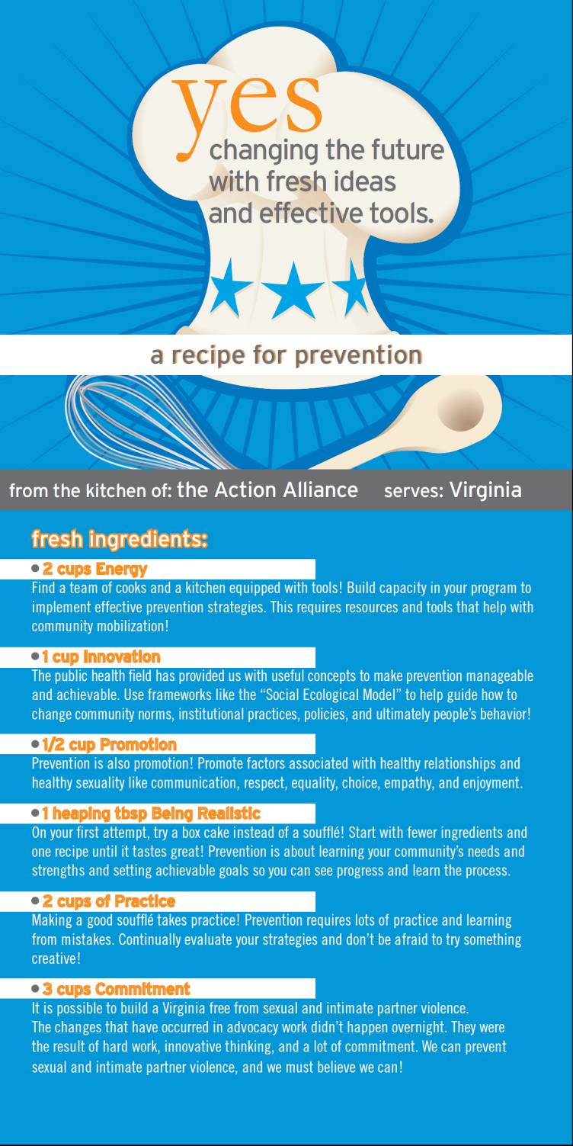
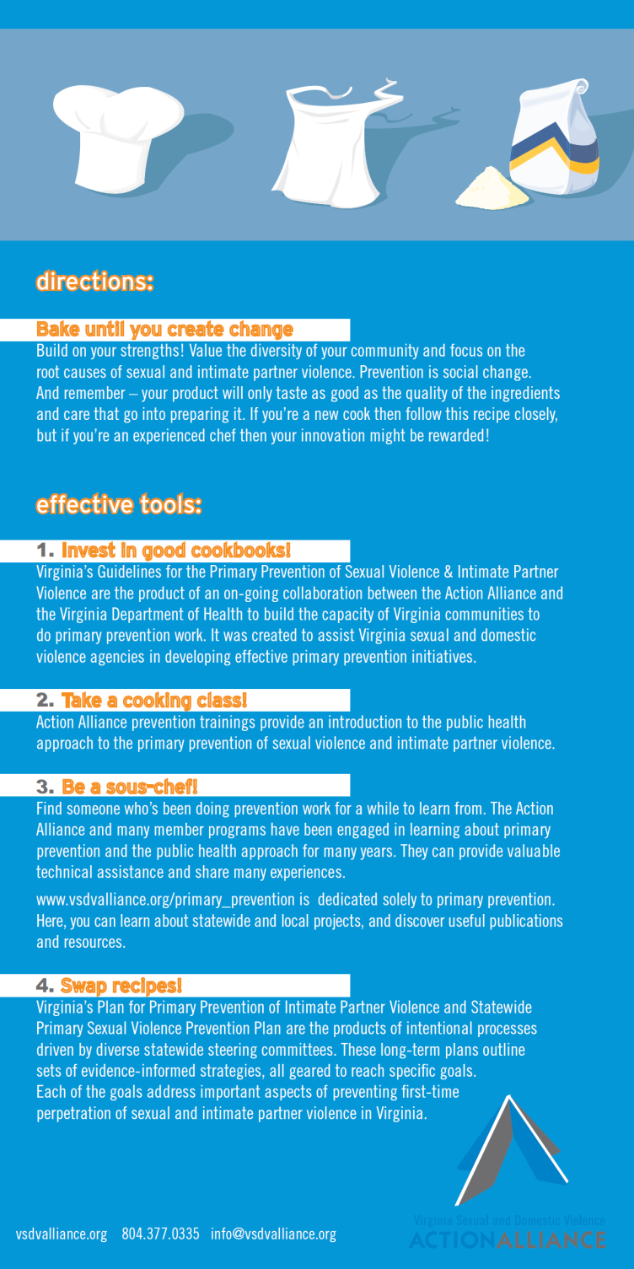

Slide 33
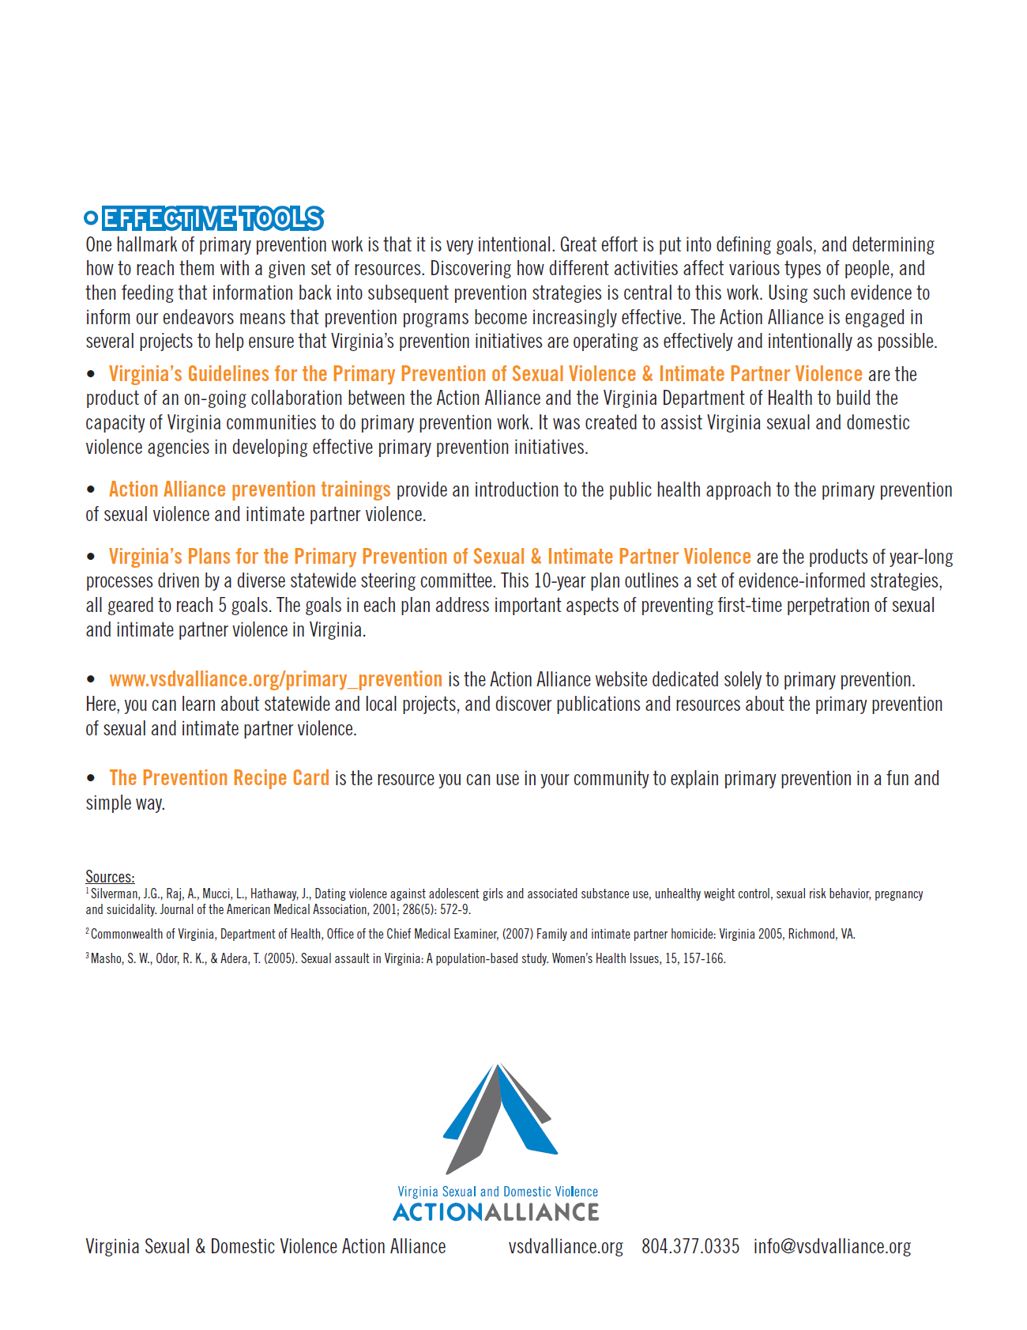
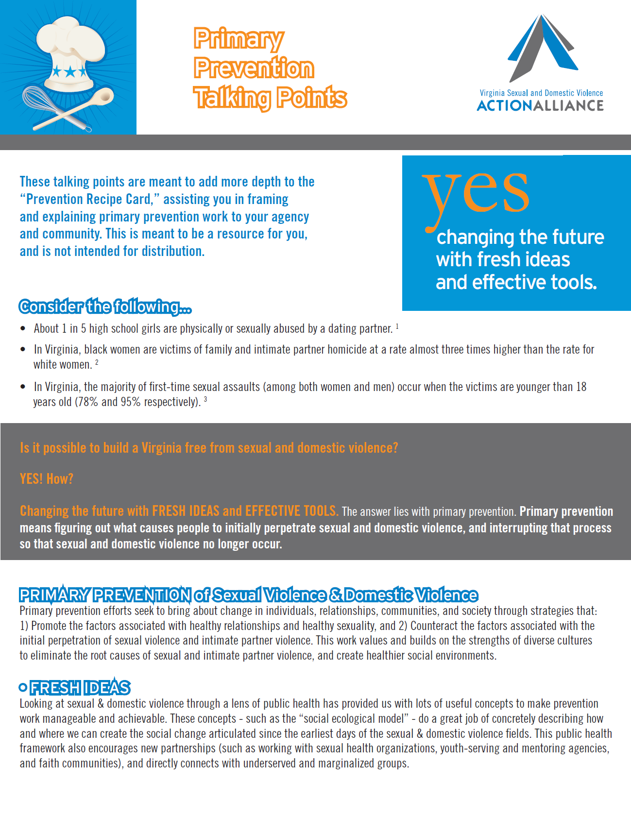

Slide 35
VA’s IPV Prevention Plan

Slide 36
Building Healthy Futures Fund

Slide 37
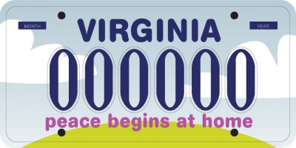
License plate designs

Slide 38
Question:
“Does primary prevention seem slightly more manageable now that you’ve learned about this stuff? Why or why not?”

